Slide 1
T3 Cancer of the Stomach

Slide 2

Anatomy
Food moves from the throat
$→$ esophagus
$→$ stomach
$→$ small bowel (jejunum)

Slide 3
Stomach Cancer Surgery Goals
Staging refers to the tests to determine
How large is the tumor?
Has there been spread to lymph nodes?
Has it spread to other parts of the body?
Treatment options depend upont the cancer stage

Slide 4
Esophageal Cancer Staging
T = Tumor - Depth of growth into the wall of the esophagus
N = Nodes - Spread to the lymph nodes
M = Metastasis - Spread to liver, lungs, or bone

Slide 5
Layers of the Wall of the Stomach
Mucosa - Inner layer
Muscle wall (muscularis)
Lymph nodes located in fat outside the muscle

Slide 6
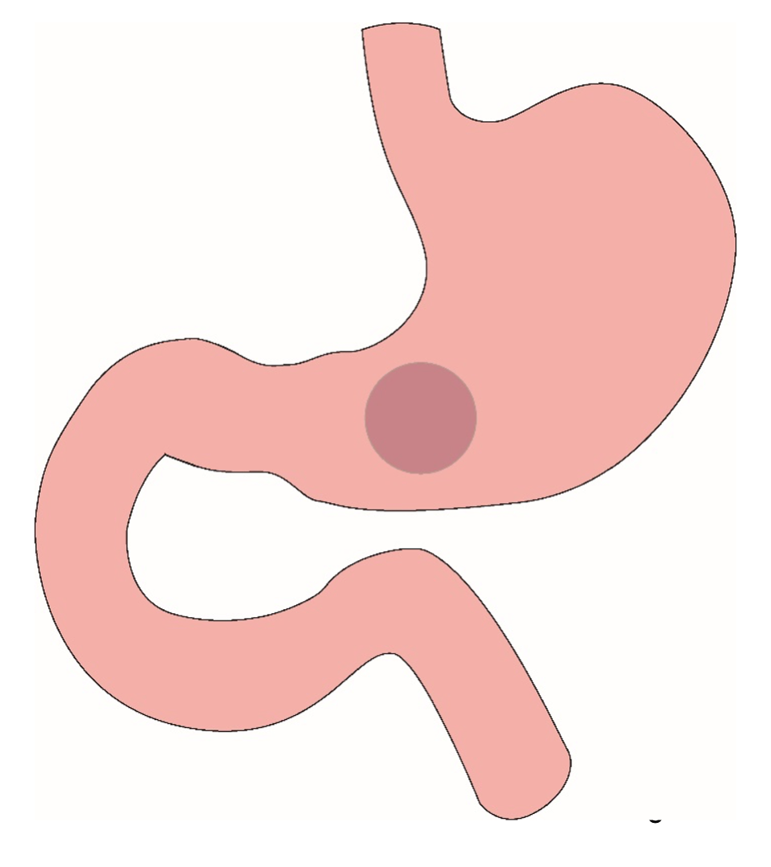
Distal Cancers
Distal cancers are those in the lower part of the stomach

Slide 7

Partial Gastrectomy
Distal gastrectomy removes the bottom portion of the stomach and performs a reconstruction

Slide 8
Distal Gastrectomy

Slide 9

Distal Gastrectomy
Distal gastrectomy removes the bottom portion of the stomach and performs a reconstruction

Slide 10
Distal Gastrectomy

Slide 11

Body Cancers
Cancers start on the very inside of the layer called the mucosa

Slide 12

Subtotal Gastrectomy
- Removes bottom 2/3 of stomach - Removes nearby lymph nodes - Reconstruction with small intestine

Slide 13
Subtotal Gastrectomy

Slide 14

Proximal Tumors
In some cases, cancer cells can break off from the main tumor and spread to lymph nodes

Slide 15

Total Gastrectomy
In some cases, cancer cells can break off from the main tumor and spread to lymph nodes

Slide 16
Total Gastrectomy

Slide 17

Dual Tract Gastrectomy
In some cases, cancer cells can break off from the main tumor and spread to lymph nodes

Slide 18
Dual Tract Gastrectomy

Slide 19

T Stage
Cancers are categorized based upon the thickness of the tumor, known as the T stage

Slide 20

N Stage
Cancers are categorized by whether there is spread to the lymph nodes.
N0 cancers have not spread to the lymph nodes
N1 cancers have spread to the lymph nodes.

Slide 21

M Stage
Some cancers spread from the esophagus to other parts of the body
M0 cancers have not spread to other parts of the body
N1 cancers have spread lungs, liver, or bone

Slide 22

PET scan
A PET scan is similar to a CT scan, and uses a small amount of tracer to light up areas of cancer.

Slide 23

Endoscopic Ultrasound
Similar to upper endoscopy (EGD)
Ultrasound probe in scope
Evaluates T stage of cancer

Slide 24

Laparoscopy
Some esophageal cancers can spread inside the abdomen
Areas of spread can be very small (grain of rice)
Laparoscopy can detect spread inside the abdomen

Slide 25
Laparoscopy
A laparoscopy is performed under a general anesthetic.
Several incisions 1/4” long
A telescope is inserted to look inside the abdominal cavity.
Biopsies can be performed.

Slide 26
Treatment Plan
- Superficial (T1) $⇒$ Endoscopic Therapy - Localized (T1b/T2) $⇒$ Surgery - Locally-advanced (T3/N1) $⇒$ Chemo $→$Surgery - Metastatic (M1) $⇒$ Chemotherapy

Slide 27
Locally-advanced Adenocarcinoma
“Sandwich” chemotherapy given before and after surgery:
Chemotherapy (8 weeks) $→$ Surgery $→$ Chemotherapy (8 weeks)
Two different drug combinations:
FLOT (more effective)
FOLFOX (better tolerated)
ECF

Slide 28
“Sandwich” Chemotherapy Drugs
FLOT
5-FU
Leucovorion
Oxaliplatin
Taxotere
FOLFOX
5-FU
Leucovorin
Oxaliplatin

Slide 29
Tumor Biomarkers
Surface proteins found on cancers which may show that additional drugs may be helpful:
HER-2 $→$ Herceptin can be helpful
PD-L1 $→$ Immunotherapy can be helpful
MMR $→$ Immunotherapy can be helpful
The biomarkers are reported in a separate pathology report
Your medical oncologist will review these with you

Slide 30
Chemotherapy
Chemotherapy drugs are administered intravenously.
There are several options for intravenous access:
Peripheral IVs in the hand
PICC line (Peripheral Inserted Central Catheter)
Central Venous Port
Central Venous Port

Slide 31
Restaging
CT or PET scan will be performed after preoperative therapy
Surgery performed after restaging
Timing depends upon recovery from therapy

Slide 32
Nutrition
Nutrition Slideshow

Slide 33
Surgery
Gastrectomy Slideshow

